Slide 1



Heterogeneity in Tomography
Three classes of object
30000 projections are taken from the three classes of objects shown above. Our first task is to cluster the projections such that each cluster contains projections from just one class.

Slide 2
Hierarchical Agglomerative Clustering
Hierarchical Agglomerative Clustering, also known as hierarchical cluster analysis, is an algorithm that groups similar objects into groups called clusters.
Hierarchical clustering starts by treating each observation as a separate cluster. Then, it repeatedly executes the following two steps:
Identify the two clusters that are closest together.
Merge the two most similar clusters.
There are two things we need to select over here – the Distance Metric and the Linkage Criteria.

Slide 3
Distance Metric and Linkage Criteria
The distance metric is the metric by which we measure the distance between two clusters. Over here, the distance metric used is the Euclidean distance as we want the projections in a cluster to be similar.
After selecting a distance metric, it is necessary to determine from where distance is computed. For example, it can be computed between the two most similar parts of a cluster (single-linkage), the two least similar bits of a cluster (complete-linkage), the centre of the clusters (mean or average-linkage).
Over here, the performance of single-linkage, average-linkage and the baseline K-means clustering have been compared.

Slide 4
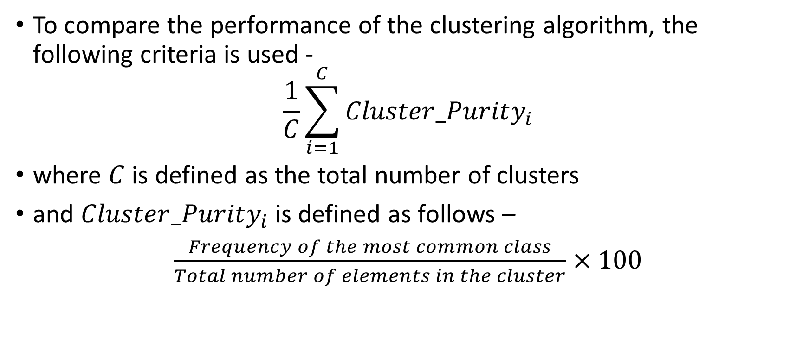
Linkage Criteria Performance
To compare the performance of the clustering algorithm, the following criteria is used -
$$\frac{1}{C}\sum_{i=1}^{C}{Cluster_Purity_{i}}$$
where $C$ is defined as the total number of clusters
and $Cluster_Purity_{i}$ is defined as follows –
$\frac{Frequency of the most common class}{Total number of elements in the cluster}×100$

Slide 5
Performance of Clustering algorithms
We compare our baseline model K-means clustering, against two variants of Hierarchical Agglomerative Clustering, one in which the single-linkage criteria is used and in the other, average-linkage criteria is used.
Thus we can see that the single-linkage criteria clusters the projections such that 99.78% of the projections belong to a single class of the object.
Clustering Algorithm | Average Cluster Purity
K-means clustering | 81.09%
Average Linkage | 82.44%
Single Linkage | 99.78%

Slide 6
Reasons for the success of single-linkage criteria
In single-linkage clustering, the distance between two clusters is determined by a single element pair, namely those two elements (one in each cluster) that are closest to each other.
In our case, the two elements that are most likely to be close are the projections taken at similar angles as all else will be same except for the heterogeneity in a small part of the projection.
If these two projections come from different classes, the heterogeneity would make a difference and the two clusters would not be merged. On the other hand, if the projections come from the same class, they would almost be the same and the clusters would be merged.

Slide 7
Assigning classes to the clusters
After creating pure clusters belonging exclusively to one object, we need to classify these clusters based on the object to which they belong.
The clusters are segregated in roughly three equal classes based on their zeroth order moment. This segregation is used as an initialization for the classes of projection.
Class | Total number of Clusters | Correctly classified | Incorrectly classified | Percentage Correct
1 | 118 | 94 | 24 | 79.66101695
2 | 90 | 65 | 25 | 72.22222222
3 | 92 | 51 | 41 | 55.43478261

Slide 8
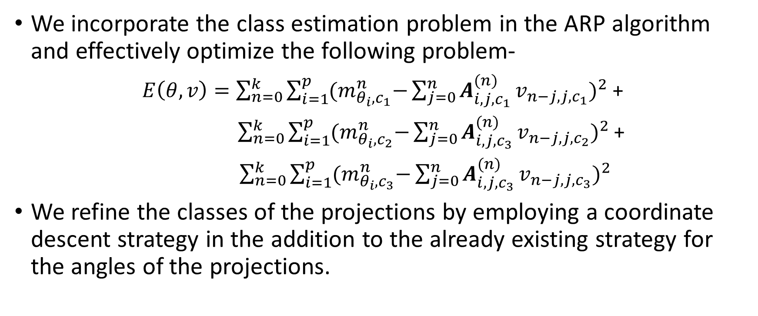
Refining class estimates
We incorporate the class estimation problem in the ARP algorithm and effectively optimize the following problem-
$E\left(θ, v\right)=\sum_{n=0}^{k}{\sum_{i=1}^{p}{{(m}_{θ_{i},c_{1}}^{n}−{{\sum_{j=0}^{n}{A_{i,j, c_{1}}^{(n)}}v}_{n−j, j,c_{1}})}^{2}}}$ +
$\sum_{n=0}^{k}{\sum_{i=1}^{p}{{(m}_{θ_{i},c_{2}}^{n}−{{\sum_{j=0}^{n}{A_{i,j,c_{3}}^{(n)}}v}_{n−j, j,c_{2}})}^{2}}}$+
$\sum_{n=0}^{k}{\sum_{i=1}^{p}{{(m}_{θ_{i},c_{3}}^{n}−{{\sum_{j=0}^{n}{A_{i,j,c_{3}}^{(n)}}v}_{n−j, j,c_{3}})}^{2}}}$
We refine the classes of the projections by employing a coordinate descent strategy in the addition to the already existing strategy for the angles of the projections.

Slide 9
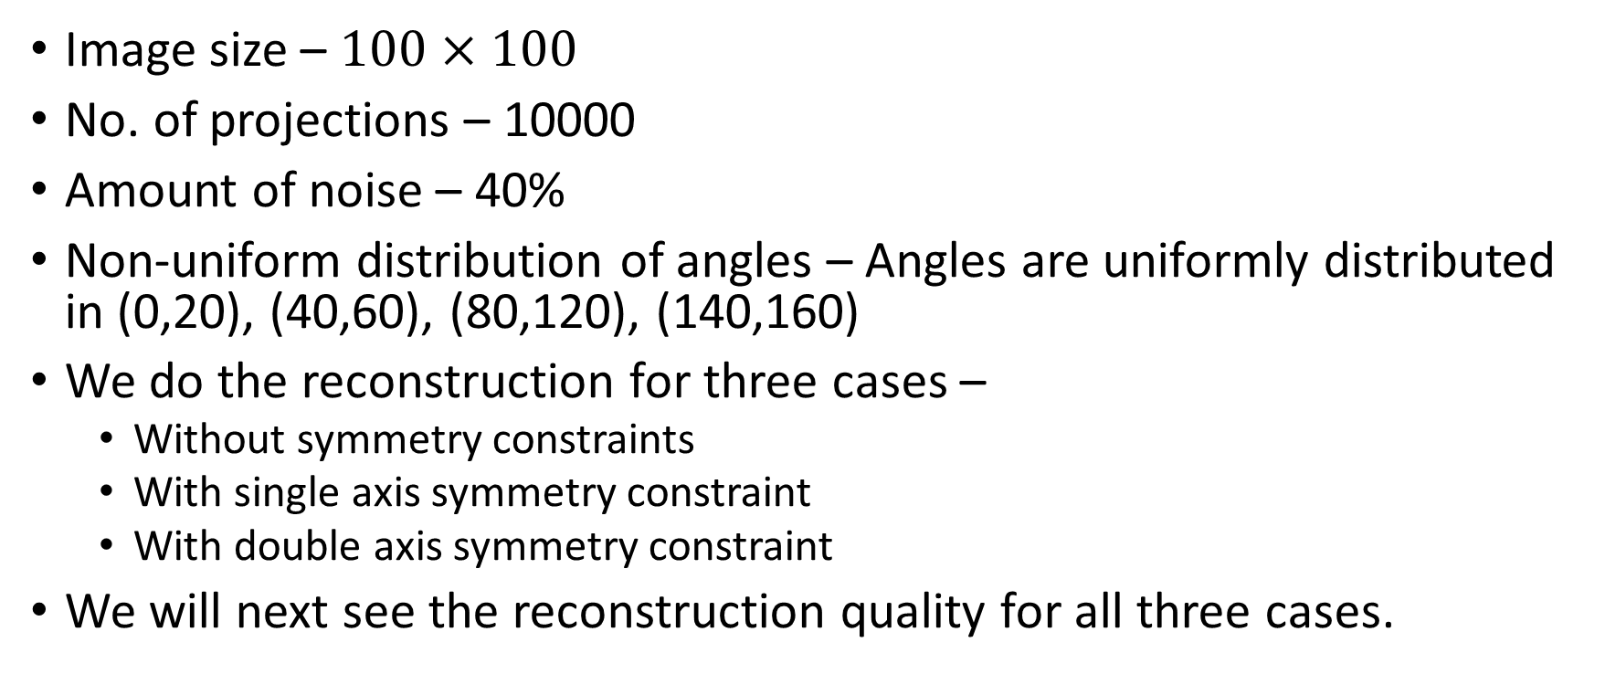
Experiment
Image size – $100×100$
No. of projections – 10000
Amount of noise – 40%
Non-uniform distribution of angles – Angles are uniformly distributed in (0,20), (40,60), (80,120), (140,160)
We do the reconstruction for three cases –
Without symmetry constraints
With single axis symmetry constraint
With double axis symmetry constraint
We will next see the reconstruction quality for all three cases.

Slide 10
Single symmetry constraint vs No symmetry constraint

Slide 11
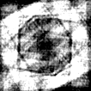
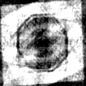
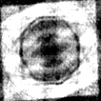
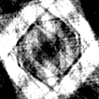
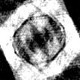
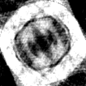
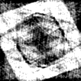
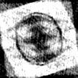
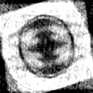
Moment-Based Estimated Images
No Symmetry constraints
Single Symmetry constraint

Slide 12
Double symmetry constraint vs No symmetry constraint

Slide 13
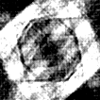
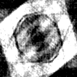
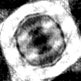
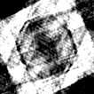
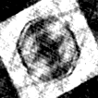
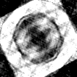
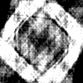
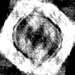
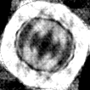
Moment-Based Estimated Images
No Symmetry constraints
Double Symmetry constraint

